Slide 1
Summary

Slide 2
Summary
Implementation
Theory

Slide 3
Theory

Slide 4
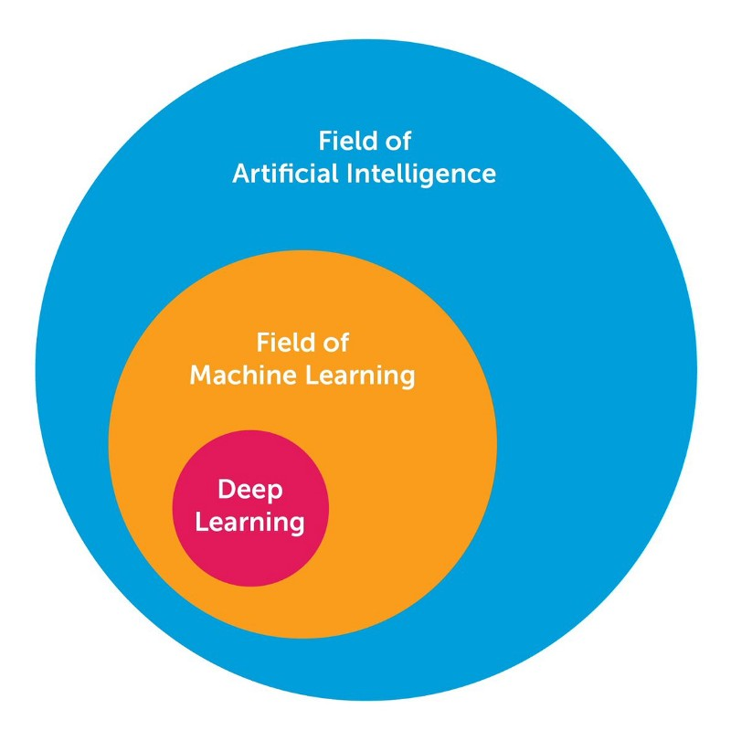

$$AI←ML←DL$$

Slide 5
Types of machine learning
Machine Learning
Supervised learning
Unsupervised learning
Reinforcement learning

Slide 6
Types of tasks
Supervised learning
Unsupervised learning
Regression problem
Classification problem
Clustering problem
Dimension reduction

Slide 7
Regression problem
«Classical»
algorithms
Neural networks

Slide 8
«Classical»
algorithms
Regression models
Autoregressive models
Decision Tree models
Linear regression
(Lasso regression, Ridge regression)
Arima
(Sarima, Regarima)
Random forest

Slide 9
Neural networks
Recurrent neural network
LSTM

Slide 10
Classification problem
«Classical»
algorithms
Neural networks

Slide 11
«Classical»
algorithms
Logistic regression

Slide 12
Neural networks
Capsule neural network

Slide 13
Machine learning
Unsupervised learning
Supervised learning
Reinforcement learning
Clustering problem
Dimension reduction
Regression problem
Classification problem
«Classical»
algorithms
Neural networks
«Classical»
algorithms
Neural networks
Regression models
Autoregressive models
Decision Tree models
LSTM neural network
Logistic regression
Capsule neural network
Linear regression
(Lasso regression, Ridge regression)
Arima
(Sarima,Regarima)
Random forest

Slide 14
Implementation

Slide 15


1. Language
Python
model building
R
Exploration and data analysis
Statistical analysis

Slide 16


2. Notebook

Slide 17


3. Libraries
scikit learn
Keras

Slide 18
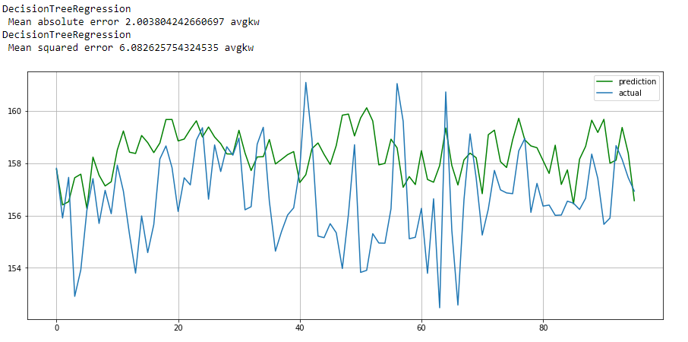
Summary
10 introductory presentations in machine learning
Comparison table of machine learning algorithms
Random Forest model

Slide 19
Полезные материалы
Курсы:
https://mlcourse.ai/
https://ru.coursera.org/learn/ekonometrika
https://ru.coursera.org/learn/supervised-learning
https://ru.coursera.org/learn/data-analysis-applications
Книги:
Саймон Хайкин: Нейронные сети. Полный курс
Книга «Глубокое обучение. Погружение в мир нейронных сетей»
Бенджио, Гудфеллоу, Курвилль: Глубокое обучение

